Slide 1
Welcome slide

Slide 2
Securing and Observing Amazon EKS clusters
GRC455 - RE:INFORCE 2024
Siva Guruvareddiar (he/him)
Rodrigo Bersa (he/him)
Senior Solutions Architect, Observability
AWS
Senior Solutions Architect, Containers
AWS
Megan Velez Rivera (she/her)
Reshma Mathews (she/her)
Senior Solutions Architect
AWS
Technical Account Manager
AWS

Slide 3







Kubernetes security challenges
Scale
Multi-tenancy
Network configuration
Different
Supply Chain
Access Control
Lack of visibility
Notes:
The first thing that our customers do when deploying containers is– establish foundational security controls
Amazon EKS security best practices:
https://aws.github.io/aws-eks-best-practices/security/docs/
AWS services, their controls, and interactions are best employed on a foundation of AWS multi-account strategy and identity and access management guardrails. These guardrails set the ability for your implementation of least privilege, separation of duties, and privacy, and provide the support for decisions about what types of controls are needed, where each security service is managed, and how they may share data and permissions in the AWS SRA.
Permissions let you specify access to AWS resources. Permissions are granted to IAM entities known as principals (users, groups, and roles). By default, principals start with no permissions. IAM principals can do nothing in AWS until you grant them permissions, and you can set up guardrails that apply as broadly as your entire AWS organization or as fine-grained as an individual combination of principal, action, resource, and conditions.
Automated, software-based security mechanisms improve your ability to securely scale more rapidly and cost-effectively. Create secure architectures, and implement controls that are defined and managed as code in version-controlled templates.
Establish a centralized logging account where all the virtual private cloud (VPC) flows logs, AWS CloudTrail logs, the AWS Config log, and all the logs of Amazon CloudWatch Logs (using subscriptions) from all the other accounts are stored.
Classify your data into sensitivity levels and use mechanisms such as encryption, tokenization, and access control where appropriate.
And finally, the focus of the presentation, Apply a defense-in-depth approach with multiple security controls. Apply multiple types of controls (for example, preventive and detective controls) to all layers, including edge of network, virtual private cloud (VPC), load balancing, instance and compute services, operating system, application configuration, and code.

Slide 4

EKS is the most secure way to run Kubernetes
EKS runs vanilla Kubernetes. EKS is upstream and certified conformant version of Kubernetes (with backported security fixes)
Security is job zero at AWS and that includes Kubernetes. AWS is a member of the Product Security Committee, who are responsible for the security the Kubernetes project.
Amazon EKS
EKS provides a managed Kubernetes experience for performant, reliable, and secure Kubernetes.
EKS makes Kubernetes operations, security, and management simple and boring.
Amazon EKS enables you to build reliable, stable, and secure applications in any environment.

Slide 5

Raise the bar on your container security posture
Integrate AWS security services to achieve centralized observability, continuous threat detection, optimized route workflows, and minimal remediation time
Empower DevSecOps teams to unify visibility and automate responses to help them achieve operational excellence in cloud security

Slide 6




Access Control
AWS APIs
Simplified Access
Granular control
Simplified Trust
Automate access
through EKS APIs with
Infra As Code (IaC) auditable by CloudTrail
Streamline clusters access for multiple roles, ServiceAccounts and AWS services
Disable or revoke access for any user, integrate with RBAC
Role policy trusts the EKS service supporting session Tags
Notes:
[SRR] – Remove “Amazon” and add coming soon to title
[Micah]
What is new in Cluster Access Management
AWS APIs - Allow administrators to fully define authorized IAM principals and their associated Kubernetes permissions directly through an EKS API, including cluster creation time, using Infra As Code tools.
Granular control - The IAM identity used to create a EKS cluster can have its Kubernetes permissions removed or scoped down to comply with security requirements, and control of a cluster can always be restored to an AWS account administrator
Simplified Access - EKS access management controls simplify the amount of work administrators need to do in order to create and manage clusters that are shared by multiple users and other AWS services.

Slide 7



AWS CloudTrail
Detection and response
Continuously detect and respond to security risks to help protect your workloads, at scale.
Amazon CloudWatch Log Insights
Amazon GuardDuty
Notes:
Maybe we just need the GuardDuty slides if we are covering only GD in the workshop.
AWS CloudTrail
Enable operational and risk auditing, governance, and compliance of your AWS account leveraging visibility on actions taken by a user, role, or an AWS service are recorded as events.
Amazon GuardDuty
Threat detection service that continuously monitors your AWS accounts and workloads for malicious activity and delivers detailed security findings for visibility and remediation.
Amazon CloudWatch Log Insights
Search and analyze your log data in Amazon CloudWatch Logs, to help you more respond to operational issues more effectively identifying potential causes and validate deployed fixes.

Slide 8


Amazon CloudWatch
Enable EKS logs: api, audit, authenticator, scheduler, controllerManager
Collect Centralized log groups per cluster
Deep integration with Amazon EKS Control plane
Use natural language for queries generation with CloudWatch Logs Insights
Search Using natural language: “Find the 10 slowest requests”
Analyze Identify and effectively respond to issues
Notes:
Kubernetes API server component logs (api) – Your cluster’s API server is the control plane component that exposes the Kubernetes API
Audit (audit) – Kubernetes audit logs provide a record of the individual users, administrators, or system components that have affected your cluster
Authenticator (authenticator) – Authenticator logs are unique to Amazon EKS; these logs represent the control plane component that Amazon EKS uses for Kubernetes role-based access control (RBAC) authentication using IAM credentials
Controller manager (controllerManager) – The controller manager manages the core control loops that are shipped with Kubernetes
Scheduler (scheduler) – The scheduler component manages when and where to run pods in your cluster

Slide 9
AWS CloudTrail
Capture Record activity as CloudTrail events
Store Retain event logs
Improve governance and audits by tracking user and API activity across your infrastructure and resources
Identify and respond to unusual activity with automated analysis
Act Trigger actions when important events are detected
Review Analyze findings for recent and historical activity
Notes:
AWS CloudTrail is a service that enables governance, compliance, operational auditing, and risk auditing of your AWS account. With CloudTrail, you can log, continuously monitor, and retain account activity related to actions across your AWS infrastructure. CloudTrail provides event history of your AWS account activity, including actions taken through the AWS Management Console, AWS SDKs, command line tools, and other AWS services. Once enabled you get a CloudTrail with all management events automatically. Then you also have several different data event sources that you can opt in to depending on your particular application and compliance needs. This event history is yet another source of observability data that we provide which simplifies security analysis, resource change tracking, and troubleshooting

Slide 10




Amazon GuardDuty
Control Plane Collects Kubernetes and VPC flow logs to detect malicious activities
Malware Scanning Detect potential presence of malware on Amazon EBS volumes
Detect threats at each layer of Kubernetes with contextualized findings for suspicious behavior
Out-of-the-box agent deployment with performance impact or hidden Amazon EC2 costs for scanning
Runtime Runtime monitoring of potential threats into host, OS, and container level context
Single Click Organization-wide protection with centralized monitoring
Notes:
Single-click organization-wide malicious file detection
Centralized monitoring, automation, and investigation
Contextualized findings to validate suspicious behavior
Out-of-the box agent Deployment
No performance impact or hidden Amazon EC2 costs for scanning
Broad runtime visibility of potential threats into host, operating system-level activities, and container-level context
Automatically collects Kubernetes and VPC flow logs to detect malicious activities
Detect potential presence of malware by scanning Amazon Elastic Block Store (Amazon EBS) volumes

Slide 11
Our plan for today
10 mins
20 mins
15 mins
10 mins
Setup
Securing
Observing
Detecting
Notes:
Implementing governance policies and controls

Slide 12



Getting started with this workshop
You have access to an AWS account with any optional pre-provisioned infrastructure and IAM policies needed to complete this workshop.
The AWS account is only available for the duration of this workshop. You will lose access to the account once the workshop is complete.
Any optional pre-provisioned infrastructure is deployed to a specific AWS Region. Make sure that you are working in this Region; other Regions are blocked.
Review the terms and conditions of the event. Do not upload any personal or confidential information to the account.

Slide 13
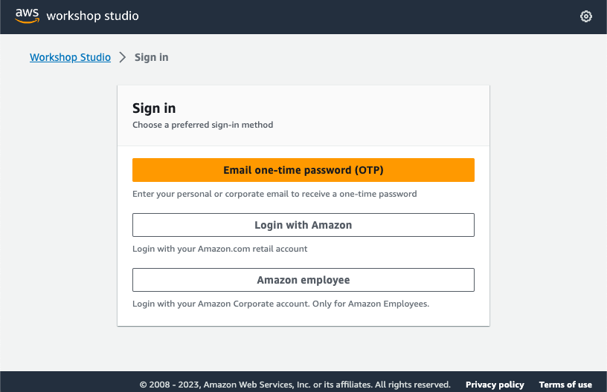
Step 1: Sign in using your preferred method
https://catalog.workshops.aws/join

Slide 14
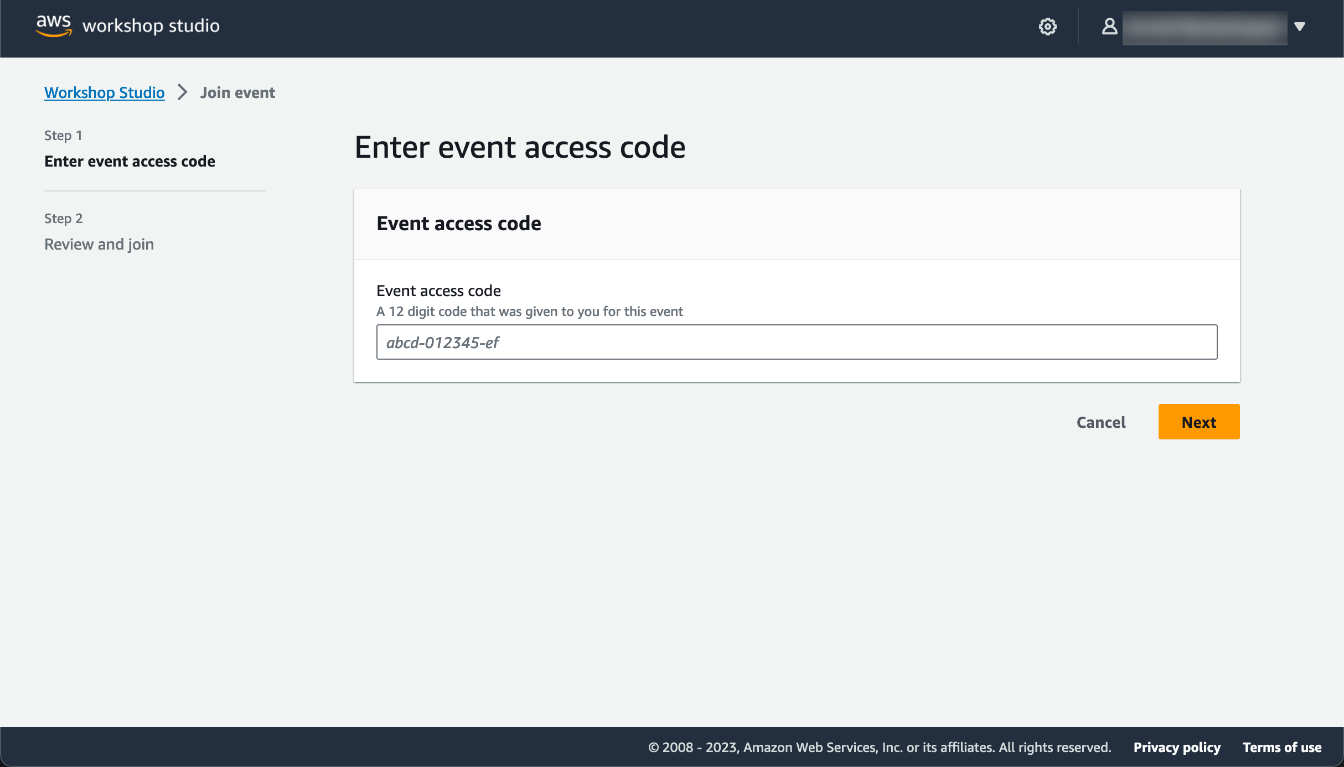
Step 2: Enter the event access code
Each session has a unique code

Slide 15
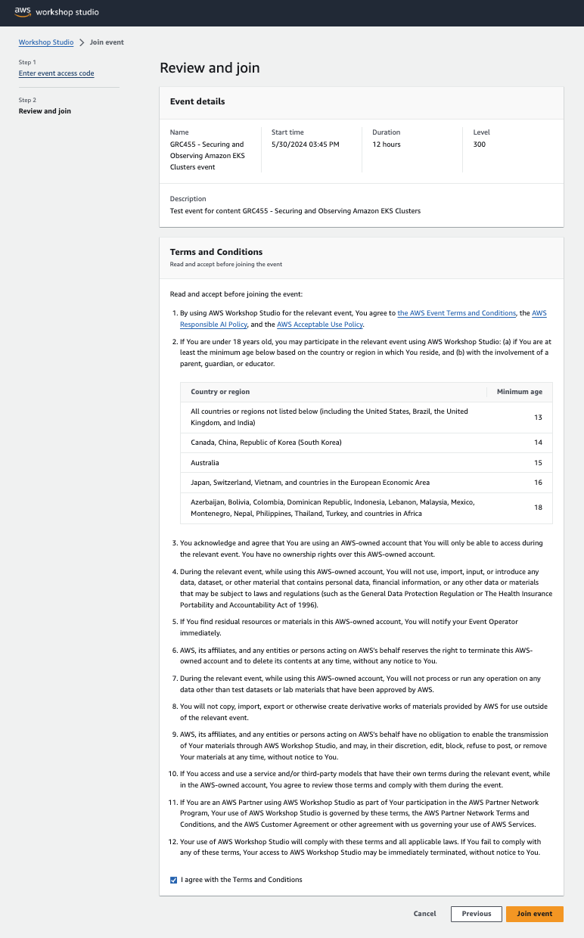
Step 3: Review terms and join event

Slide 16
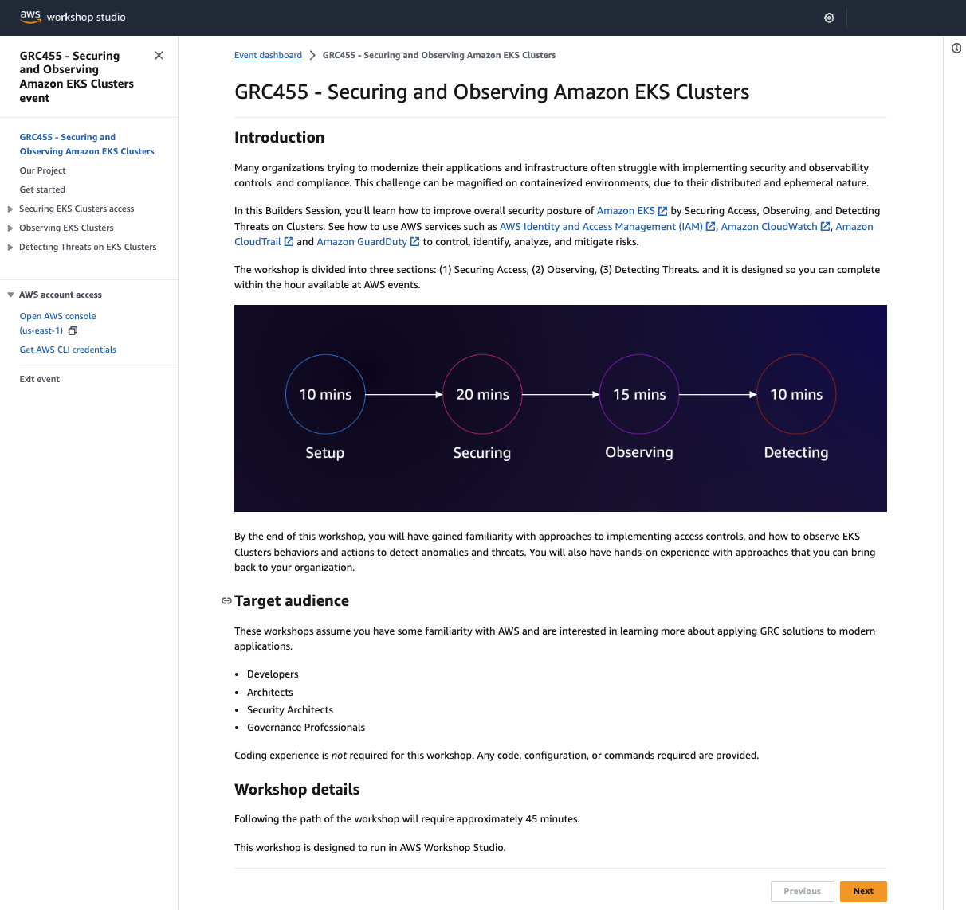
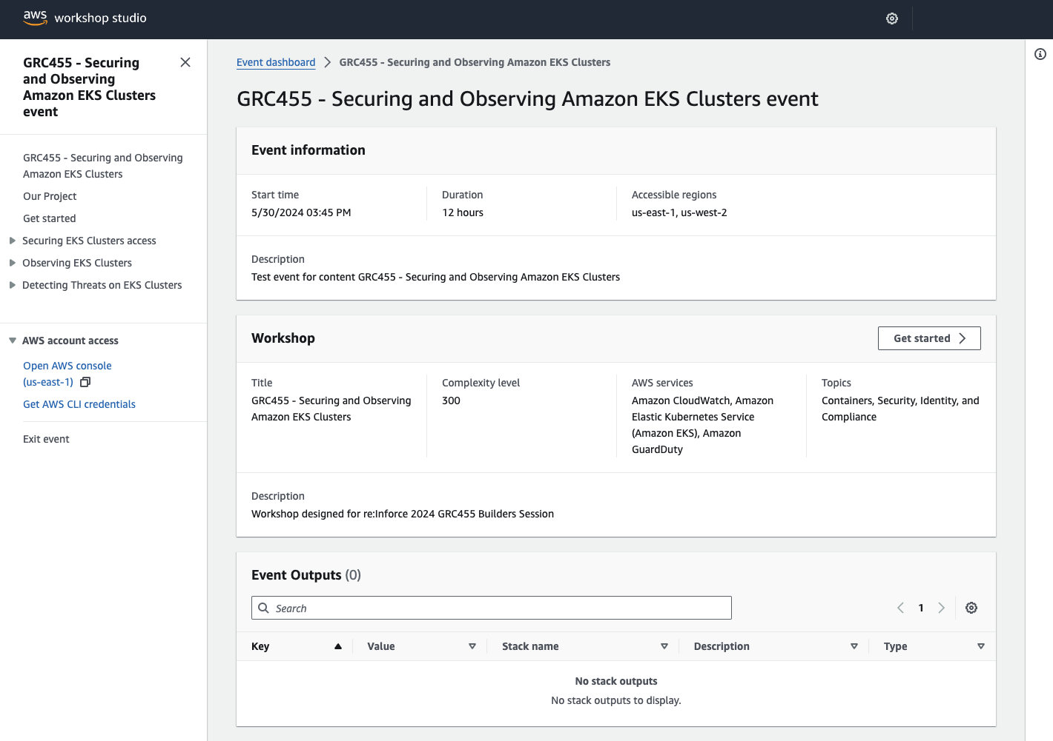
Step 4: Get started with the workshop

Slide 17
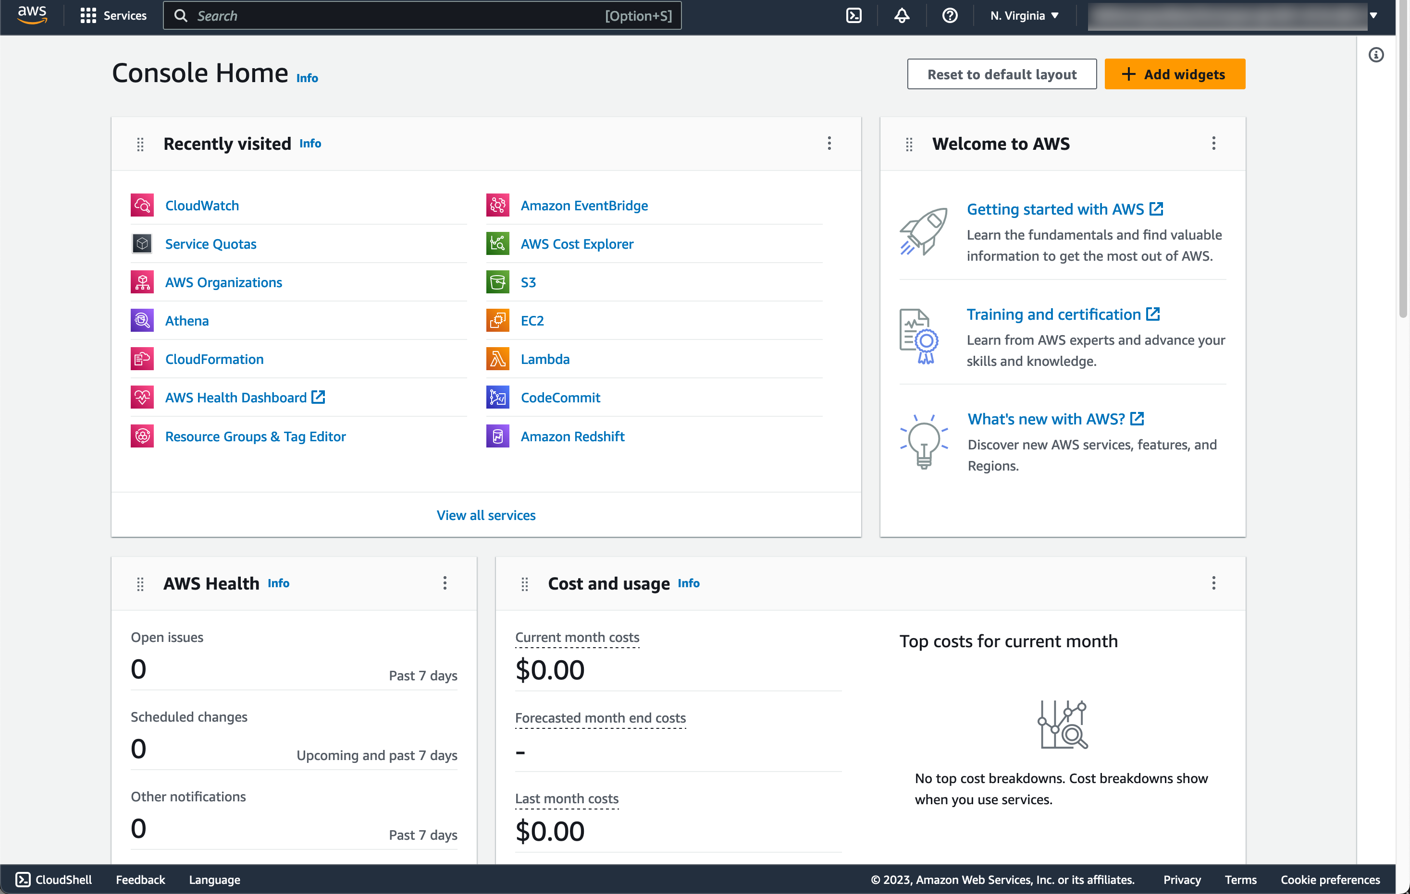
Step 5: Access AWS account
Access the AWS Management Console or generate AWS CLI credentials as needed

Slide 18

Event access code
https://catalog.workshops.aws/join
4cba-06a42a-2b
https://tinyurl.com/grc455

Slide 19
Thank you
Siva Guruvareddiar (he/him)
Rodrigo Bersa (he/him)
gurusiva@amazon.com
bersr@amazon.com
Megan Velez Rivera (she/her)
Reshma Mathews (she/her)
mevelez@amazon.com
kurampil@amazon.com

